Slide 1

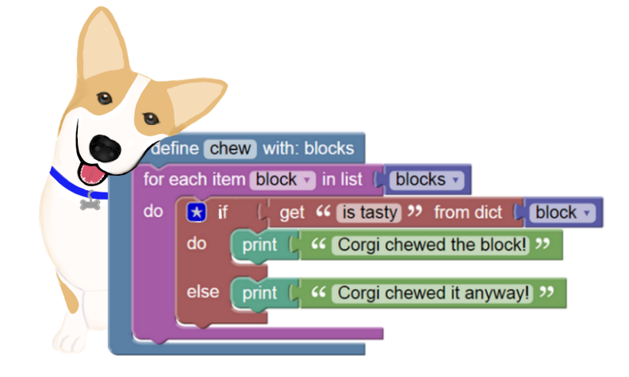
BlockPy
A Dual Block/Text Programming Environment for Python
https://www.blockpy.com

Slide 2
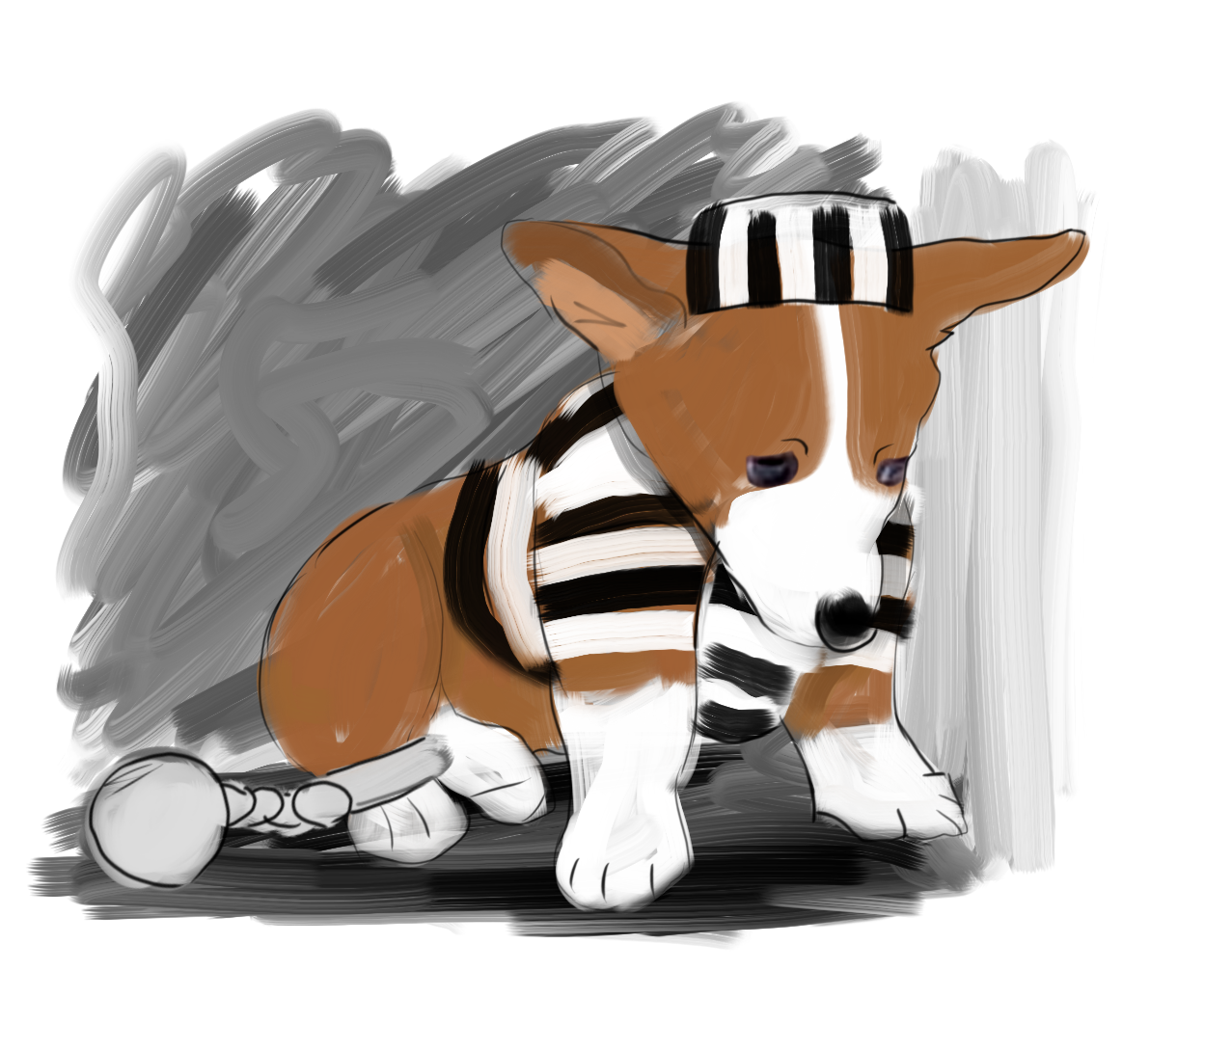


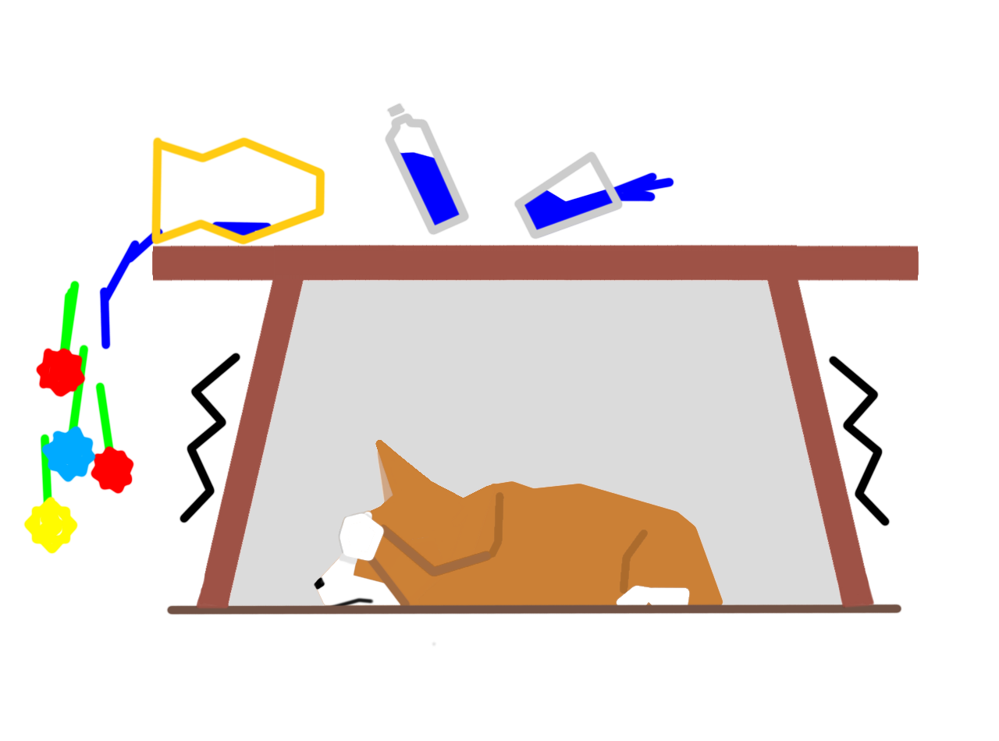

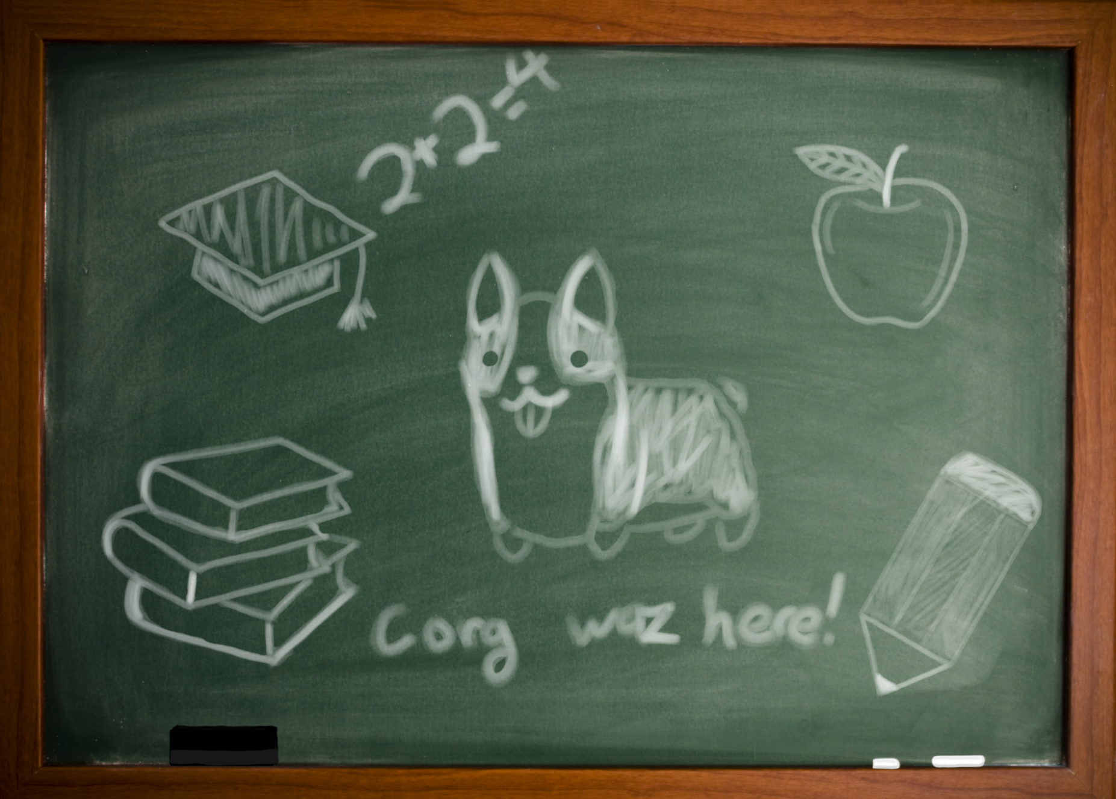
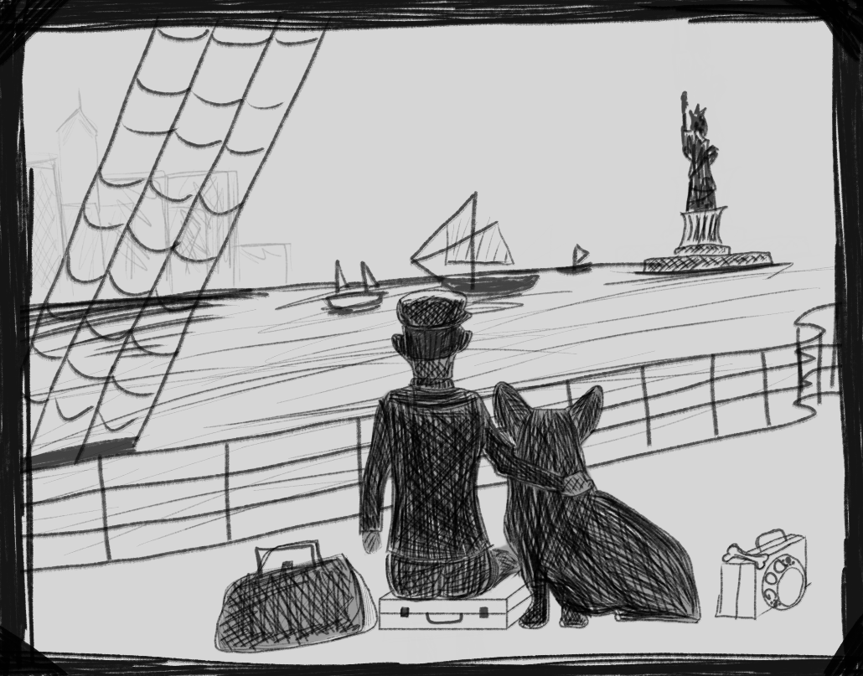


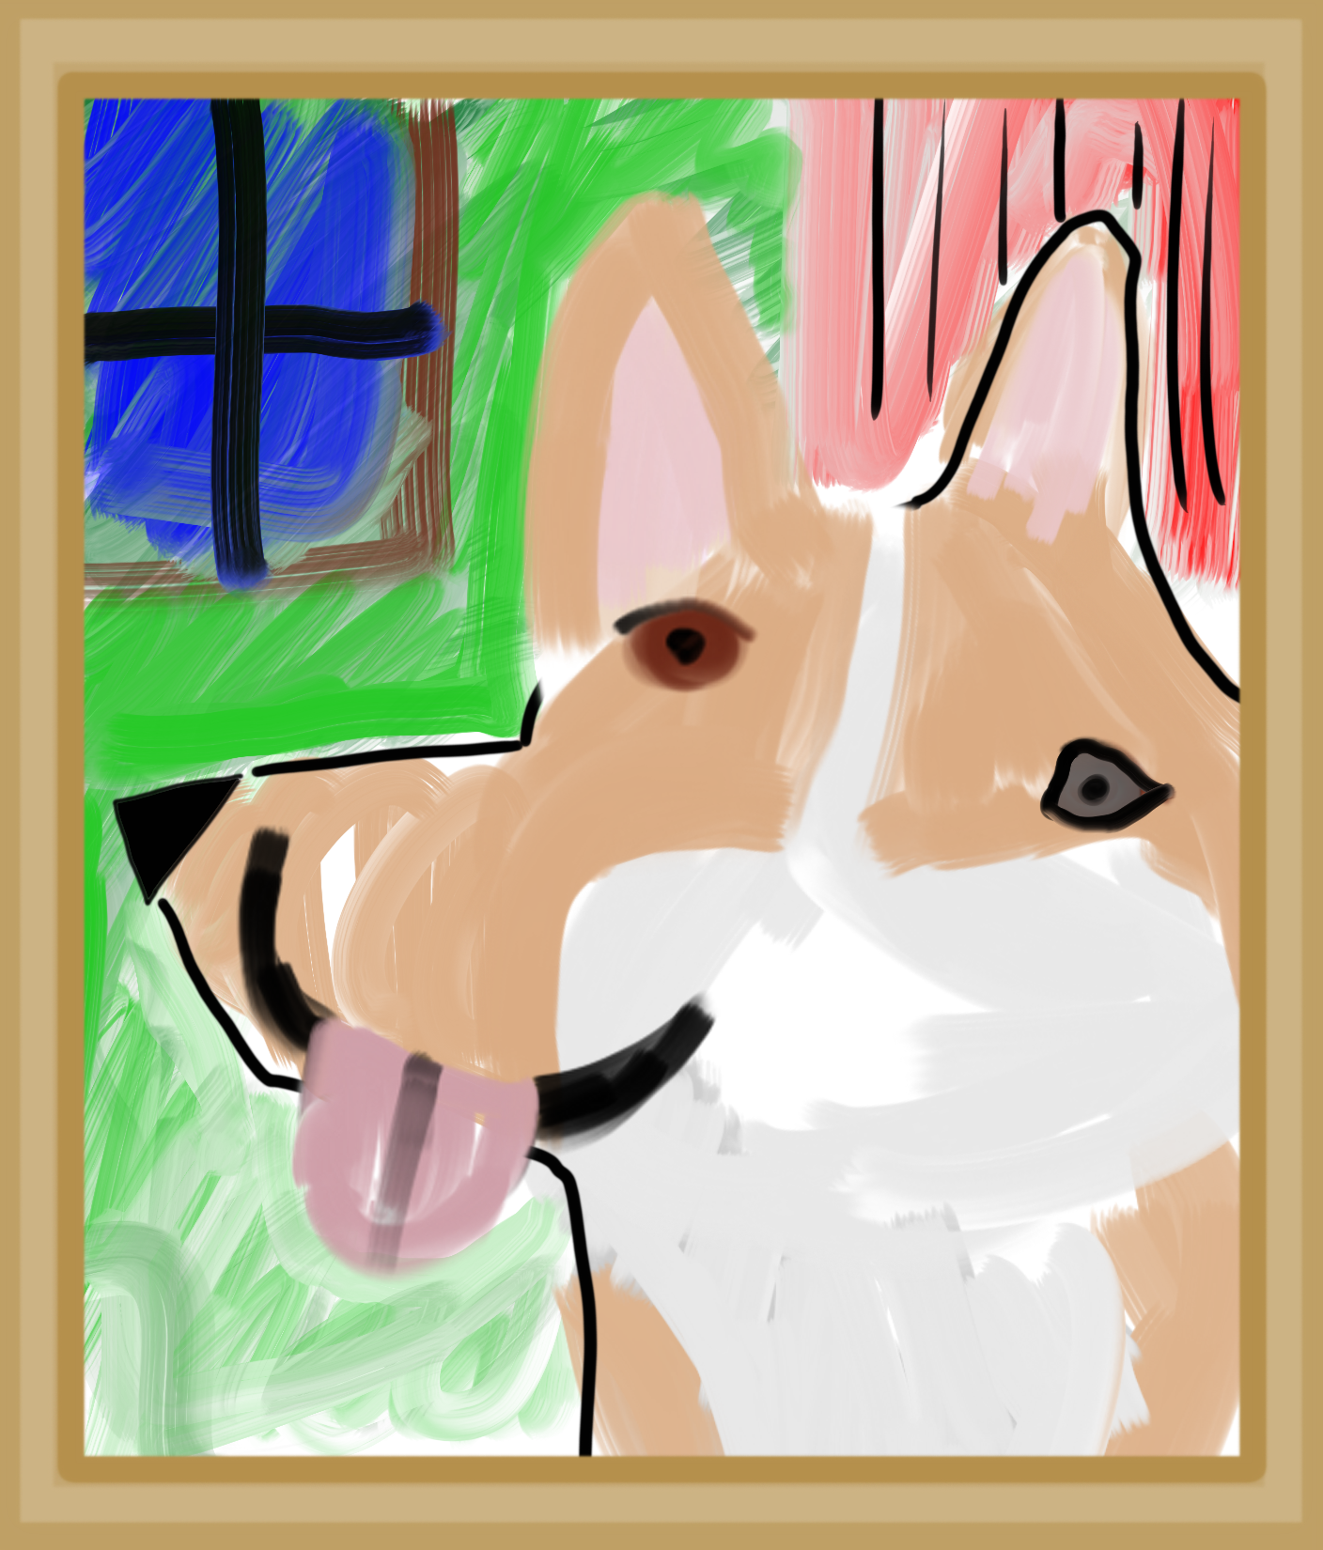
Crime
Construction
Theater
CORGIS
The Collection Of Really Great, Interesting, Situated Datasets
Earthquakes
Airlines
Education
Immigration
Books
Weather
Artwork
See the full 40+ collection at
https://think.cs.vt.edu/corgis

Slide 3
BlockPy
A Dual Block/Text Programming Environment for Python
https://www.blockpy.com

Slide 4
Crime
Construction
Theater
CORGIS
The Collection Of Really Great, Interesting, Situated, Datasets
Earthquakes
Airlines
Education
Immigration
Books
Weather
Artwork
See the full 40+ collection at
https://think.cs.vt.edu/corgis

